Slide 1
Interprocess Communication
Processes within a system may be independent or cooperating
Cooperating process can affect or be affected by other processes, including sharing data
Reasons for cooperating processes:
Information sharing
Computation speedup
Modularity
Convenience
Cooperating processes need interprocess communication (IPC)
Two models of IPC
Shared memory
Message passing

Slide 2
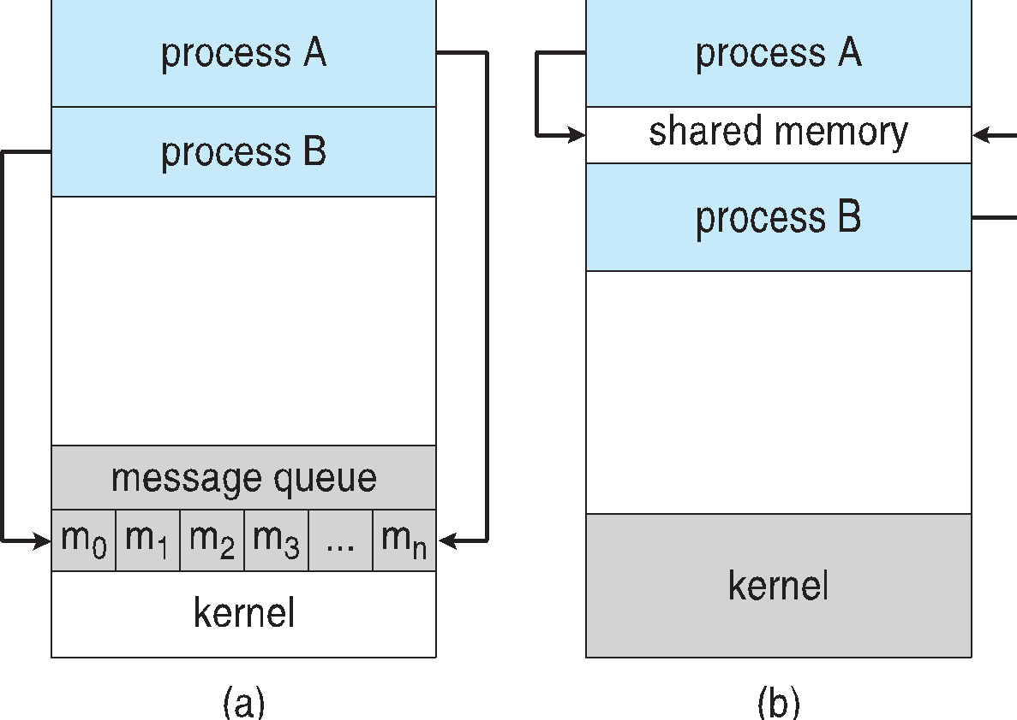
Communications Models
(a) Message passing. (b) shared memory.

Slide 3
Cooperating Processes
Independent process cannot affect or be affected by the execution of another process
Cooperating process can affect or be affected by the execution of another process
Advantages of process cooperation
Information sharing
Computation speed-up
Modularity
Convenience

Slide 4
Producer-Consumer Problem
Paradigm for cooperating processes, producer process produces information that is consumed by a consumer process
unbounded-buffer places no practical limit on the size of the buffer
bounded-buffer assumes that there is a fixed buffer size

Slide 5
Bounded-Buffer – Shared-Memory Solution
Shared data
#define BUFFER_SIZE 10
typedef struct {
. . .
} item;
item buffer[BUFFER_SIZE];
int in = 0;
int out = 0;
Solution is correct, but can only use BUFFER_SIZE-1 elements

Slide 6
Bounded-Buffer – Producer
item next_produced;
while (true) {
/* produce an item in next produced */
while (((in + 1) % BUFFER_SIZE) == out)
; /* do nothing */
buffer[in] = next_produced;
in = (in + 1) % BUFFER_SIZE;
}

Slide 7
Bounded Buffer – Consumer
item next_consumed;
while (true) { while (in == out)
; /* do nothing */ next_consumed = buffer[out];
out = (out + 1) % BUFFER_SIZE;
/* consume the item in next consumed */
}

Slide 8
Interprocess Communication – Shared Memory
An area of memory shared among the processes that wish to communicate
The communication is under the control of the users processes not the operating system.
Major issues is to provide mechanism that will allow the user processes to synchronize their actions when they access shared memory.
Synchronization is discussed in great details in Chapter 5.

Slide 9
Interprocess Communication – Message Passing
Mechanism for processes to communicate and to synchronize their actions
Message system – processes communicate with each other without resorting to shared variables
IPC facility provides two operations:
send(message)
receive(message)
The message size is either fixed or variable

Slide 10
Message Passing (Cont.)
If processes P and Q wish to communicate, they need to:
Establish a communication link between them
Exchange messages via send/receive
Implementation issues:
How are links established?
Can a link be associated with more than two processes?
How many links can there be between every pair of communicating processes?
What is the capacity of a link?
Is the size of a message that the link can accommodate fixed or variable?
Is a link unidirectional or bi-directional?

Slide 11
Message Passing (Cont.)
Implementation of communication link
Physical:
Shared memory
Hardware bus
Network
Logical:
Direct or indirect
Synchronous or asynchronous
Automatic or explicit buffering

Slide 12
Direct Communication
Processes must name each other explicitly:
send (P, message) – send a message to process P
receive(Q, message) – receive a message from process Q
Properties of communication link
Links are established automatically
A link is associated with exactly one pair of communicating processes
Between each pair there exists exactly one link
The link may be unidirectional, but is usually bi-directional

Slide 13
Indirect Communication
Messages are directed and received from mailboxes (also referred to as ports)
Each mailbox has a unique id
Processes can communicate only if they share a mailbox
Properties of communication link
Link established only if processes share a common mailbox
A link may be associated with many processes
Each pair of processes may share several communication links
Link may be unidirectional or bi-directional

Slide 14
Indirect Communication
Operations
create a new mailbox (port)
send and receive messages through mailbox
destroy a mailbox
Primitives are defined as:
send(A, message) – send a message to mailbox A
receive(A, message) – receive a message from mailbox A

Slide 15
Indirect Communication
Mailbox sharing
P₁, P₂, and P₃ share mailbox A
P₁, sends; P₂ and P₃ receive
Who gets the message?
Solutions
Allow a link to be associated with at most two processes
Allow only one process at a time to execute a receive operation
Allow the system to select arbitrarily the receiver. Sender is notified who the receiver was.

Slide 16
Examples of IPC Systems - POSIX
POSIX Shared Memory
Process first creates shared memory segment shm_fd = shm_open(name, O CREAT | O RDWR, 0666);
Also used to open an existing segment to share it
Set the size of the object
ftruncate(shm fd, 4096);
Now the process could write to the shared memory
sprintf(shared memory, "Writing to shared memory");

Slide 17
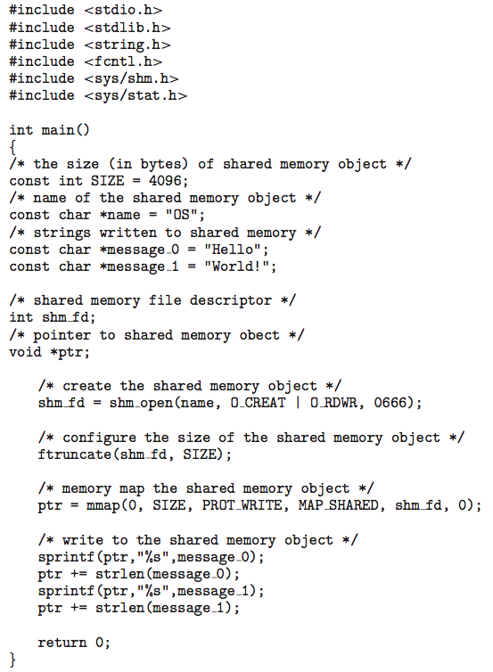
IPC POSIX Producer

Slide 18
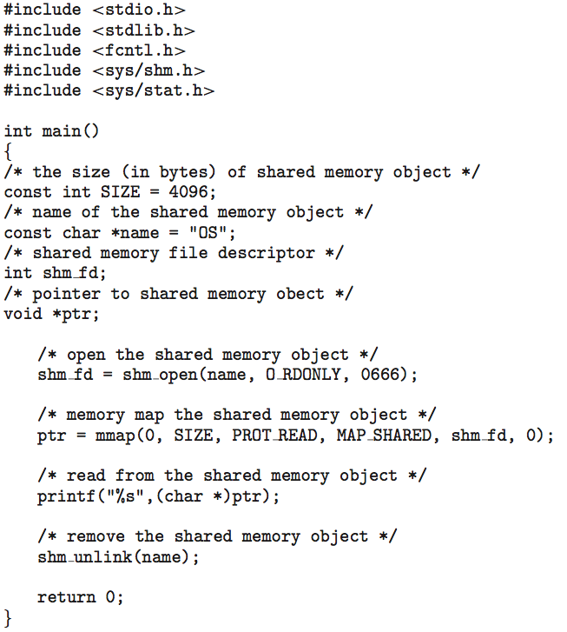
IPC POSIX Consumer

Slide 19
Pipes
Acts as a conduit allowing two processes to communicate
Issues:
Is communication unidirectional or bidirectional?
In the case of two-way communication, is it half or full-duplex?
Must there exist a relationship (i.e., parent-child) between the communicating processes?
Can the pipes be used over a network?
Ordinary pipes – cannot be accessed from outside the process that created it. Typically, a parent process creates a pipe and uses it to communicate with a child process that it created.
Named pipes – can be accessed without a parent-child relationship.

Slide 20
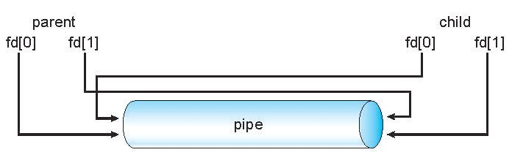
Ordinary Pipes
Ordinary Pipes allow communication in standard producer-consumer style
Producer writes to one end (the write-end of the pipe)
Consumer reads from the other end (the read-end of the pipe)
Ordinary pipes are therefore unidirectional
Require parent-child relationship between communicating processes
Windows calls these anonymous pipes
See Unix and Windows code samples in textbook

Slide 21
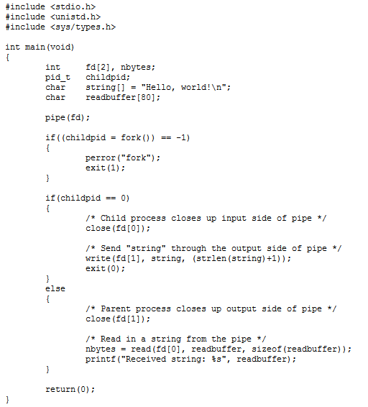
Creating Pipe Example

Slide 22
Named Pipes (FIFO)
Named Pipes are more powerful than ordinary pipes
Communication is bidirectional
No parent-child relationship is necessary between the communicating processes
Several processes can use the named pipe for communication
Provided on both UNIX and Windows systems

Slide 23
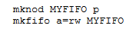
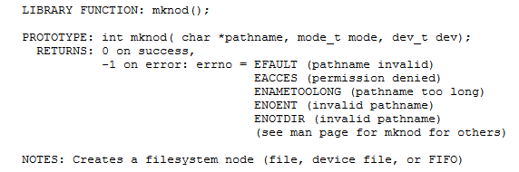
Creating FIFO Example
From Linux Shell:
Using system call:

Slide 24

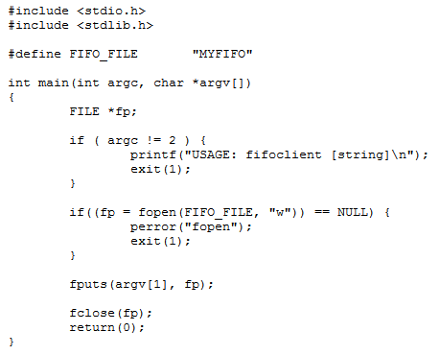
FIFO Operations
Server Process
Client Process

